Slide 1
Detecting Malicious Websites using Machine Learning

Slide 2
THE TEAM
JAYAKRISHNAN J U | LMC 17 MCA 003
LEKSHMI S R | LLMC 17 MCA 020
STEPHY JOBOY | LLMC 17 MCA 031

Slide 3
ACKNOWLEDGEMENT
Dr. MOHANLAL P P -Principal, LMCST, Tvm
Mr. JUSTIN G RUSSEL– Internal guide(Project Supervisor),
Asst.Professor LMCST, Dept.Of MCA , Tvm
Mrs.SELMA JOSEPH – HOD, Dept Of MCA , LMCST ,Tvm

Slide 4
AIM
To Develop a Machine Learning based add-on for detecting phishing websites online.

Slide 5
OBJECTIVE
To create a system based on Machine Learning approach for identifying phishing websites by :
Extracting Data from a live website.
Clearly listing out 22 features of a phishing website.
Training the Model
Testing , Evaluating & Implementing the model

Slide 6
KEYWORDS
Phishing is a cybercrime in which a target or targets are contacted by email, telephone or text message by someone posing as a legitimate institution to lure individuals into providing sensitive data such as personally identifiable information, banking and credit card details, and passwords.
Machine learning is an application of artificial intelligence (AI) that provides systems the ability to automatically learn and improve from experience without being explicitly programmed. Machine learning focuses on the development of computer programs that can access data and use it learn for themselves

Slide 7
3. Training – a way by which the machine learning model is taught or
made to learn by a self study process
To train an ML model, you need to specify the following:
a. Input training datasource
b. Name of the data attribute that contains the target to be predicted
c. Required data transformation instructions
d. Training parameters to control the learning algorithm

Slide 8
Training: While training for machine learning, you pass an algorithm with training data. The learning algorithm finds patterns in the training data such that the input parameters correspond to the target. The output of the training process is a machine learning model which you can then use to make predictions. This process is also called “learning”.

Slide 9
4. Testing : A process by which machine learning model is evaluated
5. Model: A machine learning model can be a mathematical representation
of a real-world process.
6. Features: Features are individual independent variables that act as the input in your system. Prediction models use features to make predictions. New features can also be obtained from old features using a method known as ‘feature engineering’. More simply, you can consider one column of your data set to be one feature. Sometimes these are also called attributes. And the number of features are called dimensions.

Slide 10
7. Classification: In classification, you will need to categorize data into predefined classes. For example, an email can either be ‘spam’ or ‘not spam’.
8. Feature selection, also known as variable selection, attribute selection or variable subset selection, is the process of selecting a subset of relevant features (variables, predictors) for use in model construction. Feature selection techniques are used for several reasons:
a. implification of models to make them easier to interpret by researchers/users,
b. shorter training times,
c. to avoid the curse of dimensionality

Slide 11
Existing system
The existing approaches for anti phishing are:
Detect and block the phishing Web sites manually in time
Enhance the security of the web sites at the time of developing
Installing online anti-phishing software in user’s computers

Slide 12

PROBLEMS
Everything online-> is your data secure??
Cyber attacks- huge threat in current days
Monetary loss
Theft of private information
Malware installation
Virus, etc…
Cause losses of billions of dollars every year.

Slide 13
Proposed system
The following are the activities performed in the proposed system:
Classification using various features.
Using RANDOM FOREST ALGORITHM for finding the phishing SITES
Creating ADD- ON using javascript, implemented using python machine
learning

Slide 14
INTRODUCTION

Slide 15

Phishing ?
As you see above, the site of facebook in those images look the same. But we are unable to identify which is the real website. This is termed as phishing. The above shown image is an clear concept of phishing.

Slide 16
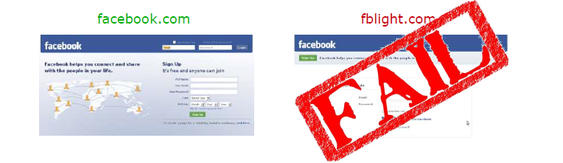
Website: Normal and Malicious - difference

Slide 17
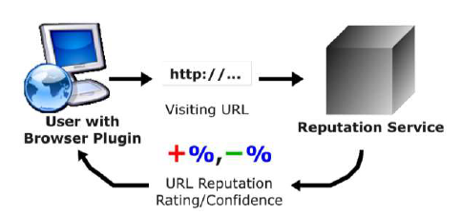
Its Rectification Method

Slide 18
IMPLEMENTATION

Slide 19
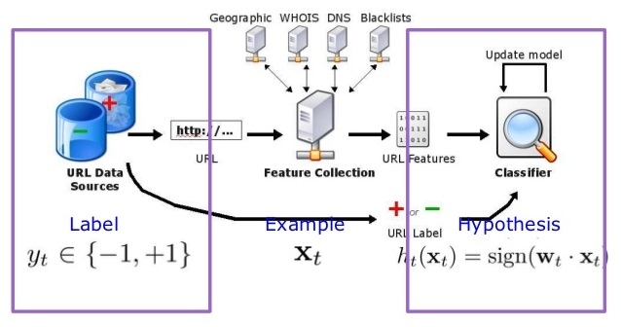
URL CLASSIFICATION SYSTEM

Slide 20
FEATURES

Slide 21
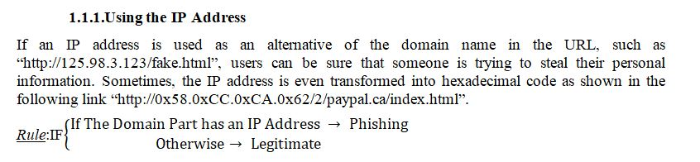
Address Bar based Features

Slide 22
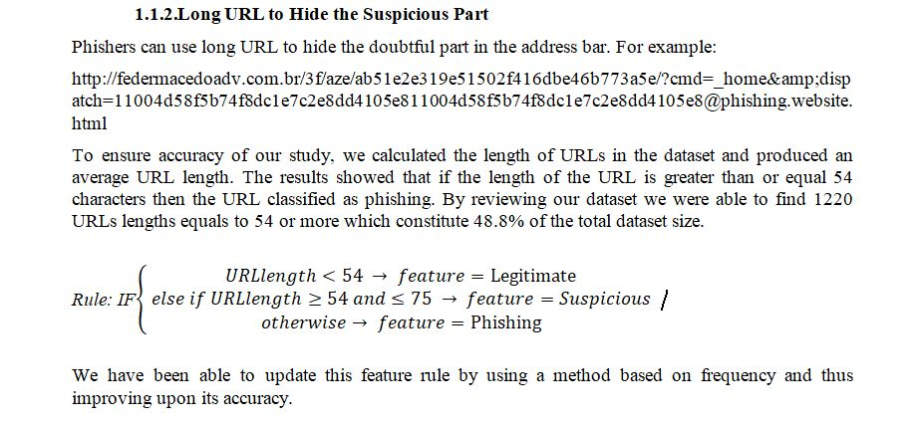

Slide 23
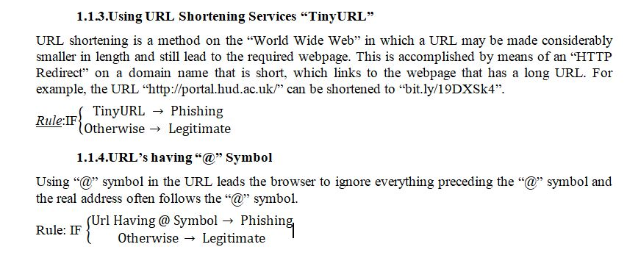

Slide 24
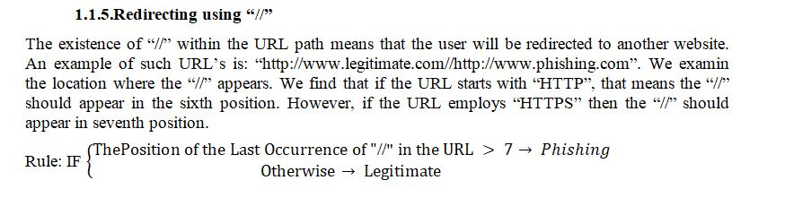

Slide 25
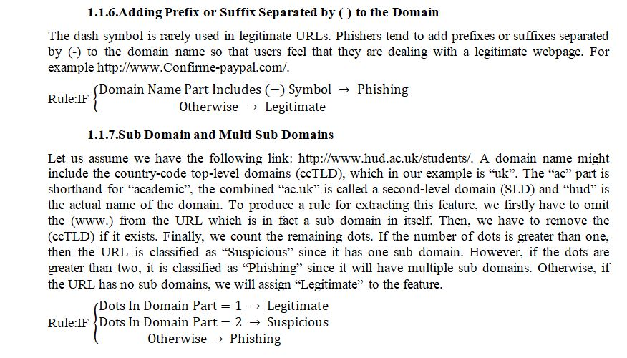

Slide 26
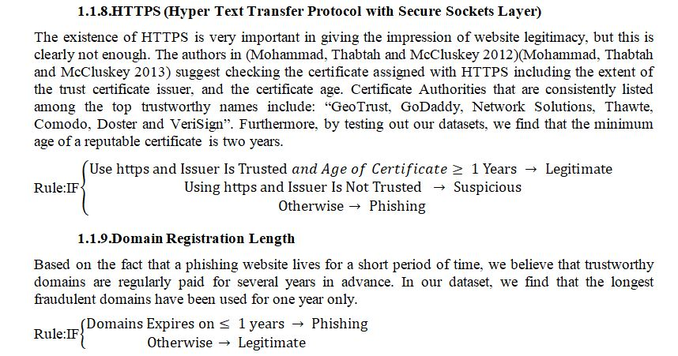

Slide 27
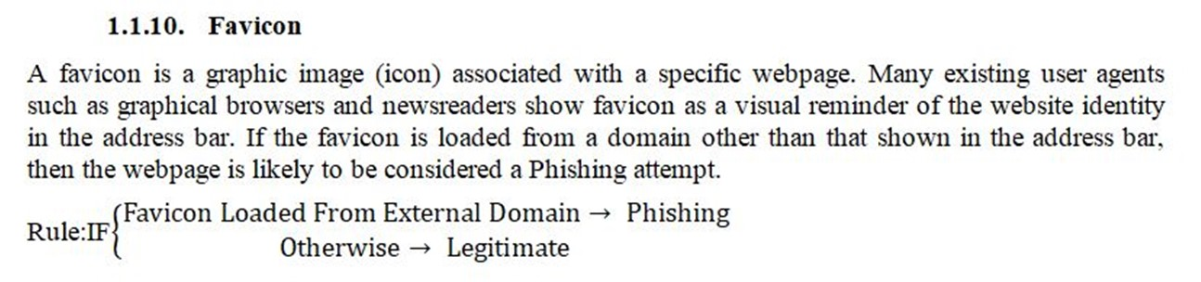

Slide 28
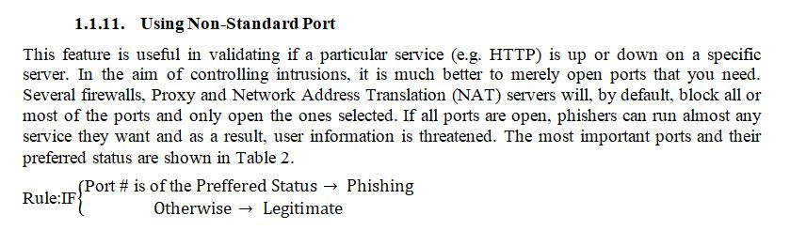

Slide 29
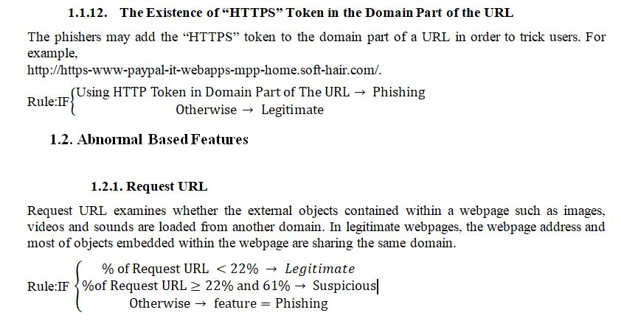

Slide 30
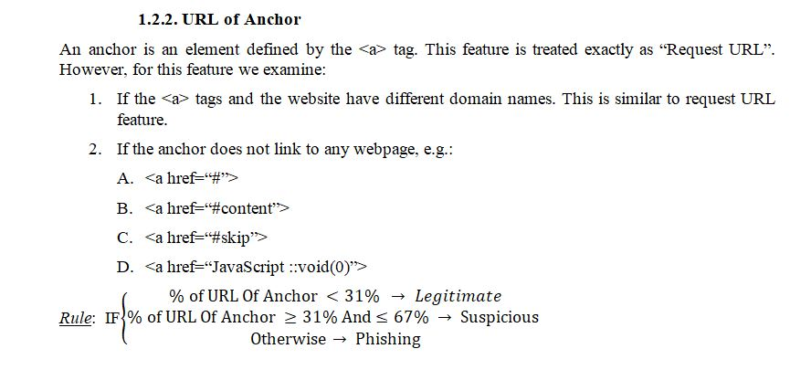

Slide 31
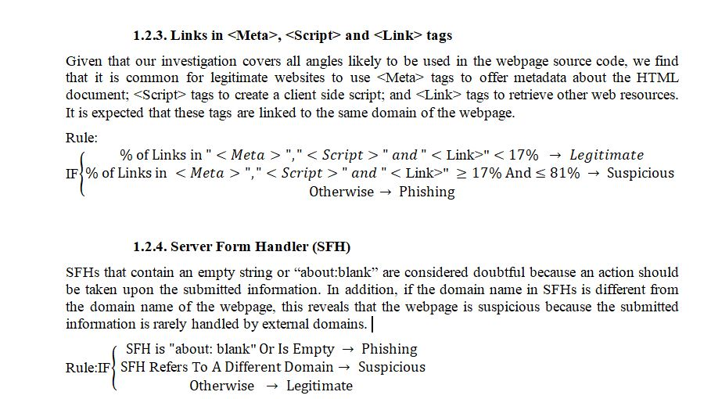

Slide 32
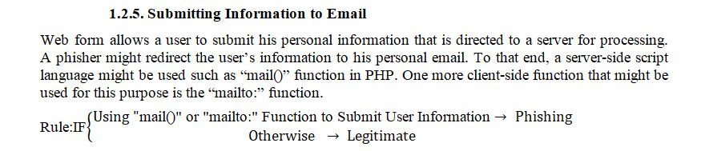

Slide 33
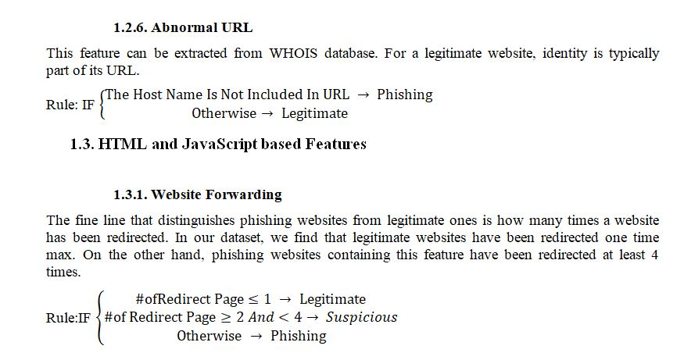

Slide 34
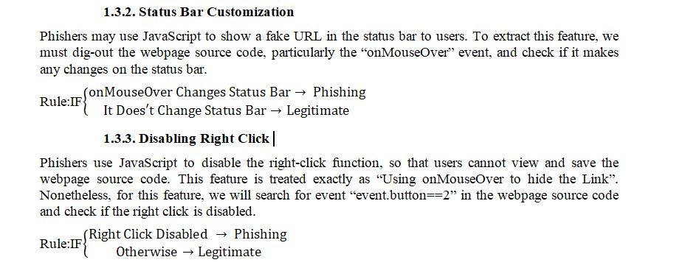

Slide 35
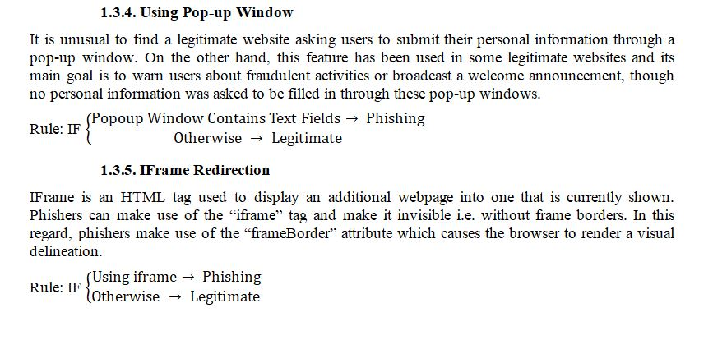

Slide 36
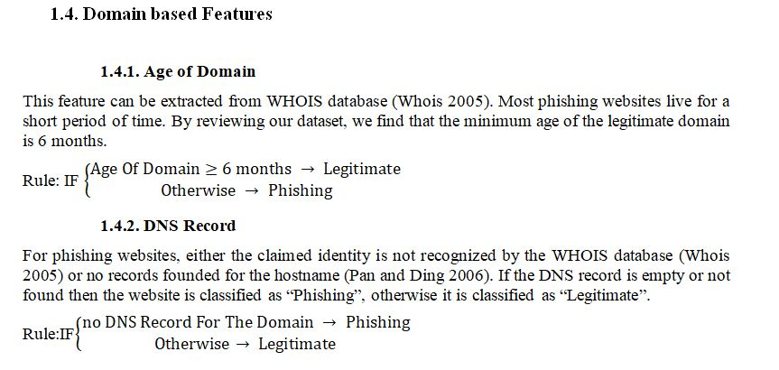

Slide 37
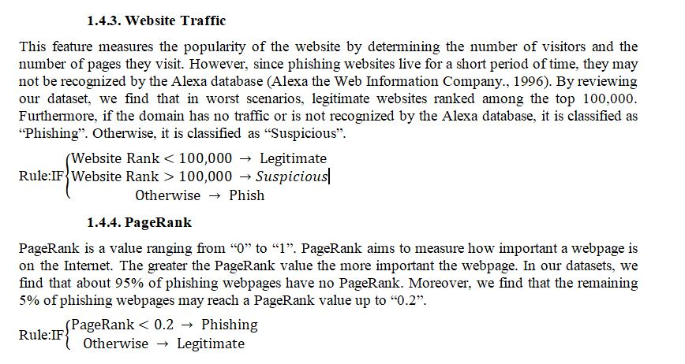

Slide 38
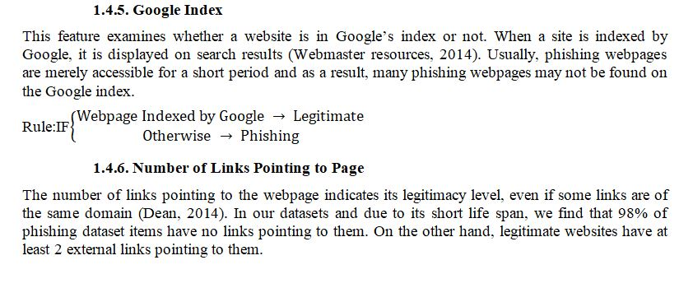

Slide 39
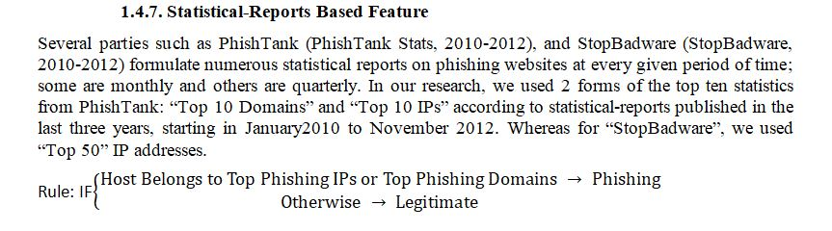

Slide 40
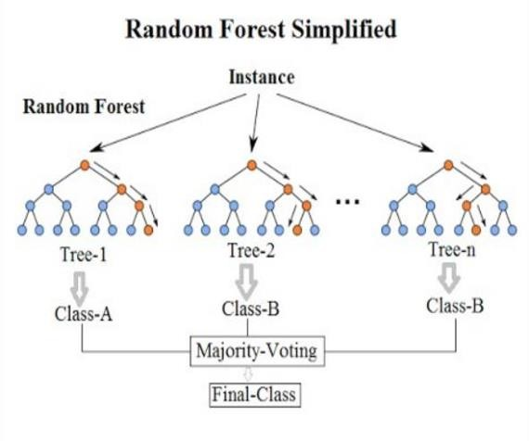
Random Forest Classification Algorithm
A simple & easy to use algorithm
Consists of trees – more the trees, more robust the algorithm
Creates decision tress for randomly selected data samples, get predictions and selects the best solution among all the predications ie by voting.

Slide 41
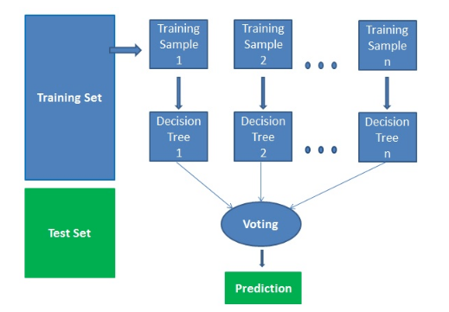
Algorithm-Its working
Selects various data samples
Makes decision trees
Performs a vote for each
predicated results.
Selects best predication by
voting as the final result.`

Slide 42
SPECIFICATIONS
Software Requirements
Operating system: Windows
Front end: HTML Java Script
Back end: HTML Data (Text File)
Environment: Python IDLE 2.7.15
Hardware Requirements
Processor: Intel i3
RAM: 4 GB
Hard disk: 160 GB
Monitor: 19 inch
CD Drive: 52x Optical Drive
Keyboard: 108 keys

Slide 43
PROGRAMMING ENVIRONMENT

Slide 44
XAMPP
XAMPP is an open source software developed by Apache friends. XAMPP software package contains Apache distributions for Apache server, MariaDB, PHP, and Perl. And it is basically a local host or a local server. This local server works on your own desktop or laptop computer. The use of XAMPP is to test the clients or your website before uploading it to the remote web server. This XAMPP server software gives you the suitable environment for testing MYSQL, PHP, Apache and Perl projects on the local computer.

Slide 45
PHP
PHP is a server side scripting language that is used to develop Static websites or Dynamic websites or Web applications. PHP stands for Hypertext Pre-processor, that earlier stood for Personal Home Pages.
PHP scripts can only be interpreted on a server that has PHP installed.

Slide 46
PYTHON
Python is an interpreted, object-oriented, high-level programming language with dynamic semantics. Its high-level built in data structures, combined with dynamic typing and dynamic binding, make it very attractive for Rapid Application Development, as well as for use as a scripting or glue language to connect existing components together.

Slide 47
Packages used
The following are the python packages used:
Joblib version 0.13.1
Scikit-Learn
NumPy
beautifulsoup4
Whois
Google

Slide 48
Joblib version 0.13.1
Joblib is a set of tools to provide lightweight pipelining in Python. In particular:
transparent disk-caching of functions and lazy re-evaluation (memorize pattern)
easy simple parallel computing
Joblib is optimized to be fast and robust in particular on large data and has specific optimizations for NumPy arrays. It is BSD-licensed.

Slide 49
Scikit-Learn
Scikit-learn is a free machine learning library for Python. It features various algorithms like support vector machine, random forests, and k-neighbours, and it also supports Python numerical and scientific libraries like NumPy and SciPy.

Slide 50
NumPy
NumPy is the fundamental package for scientific computing with Python. It contains among other things:
A powerful N-dimensional array object
Sophisticated (broadcasting) functions
Tools for integrating C/C++ and Fortran code

Slide 51
beautifulsoup4
Beautifulsoup4 is a Python library for pulling data out of HTML and XML files. It works with your favorite parser to provide idiomatic ways of navigating, searching, and modifying the parse tree. It commonly saves programmers hours or days of work.

Slide 52
Whois
Whois is a query and response protocol that is widely used for querying databases that store the registered users or assignees of an Internet resource, such as a domain name, an IP address block or an autonomous system, but is also used for a wider range of other information. The protocol stores and delivers database content in a human-readable format. The WHOIS protocol is documented in the Advanced Research Project Agency Network (ARPANET) .

Slide 53
Google Search Python Package
Run a Google search and fetch the individual results (full HTML and text contents). By default the result URLs are fetched eagerly when the search request is made with 10 parallel requests. Fetching can be deferred until searchResult.getText() or getMarkup() are called by passing prefetch_results = False to the search method.
Pass num_results to the search method to set the maximum number of results.
SearchReponse.total gives the total number of results on Google.

Slide 54
WORKING MECHANISM

Slide 55
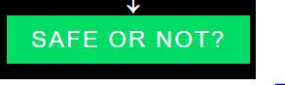
Turn on XAMPP control panel and connect to Apache server
Visit any website
Click the add-on on the top right corner of the browser
Click the green button
Wait for the result to be printed.
At that time, the source code gets copied to an text file. It then checks with the
parameters (i.e 22 features) and then results are displayed accordingly.
It is that final result printed in big font after going through this sequential process.
It works on any website you throw at it and this process is repeated for every click of the
add-on.

Slide 56
SCREENSHOTS

Slide 57
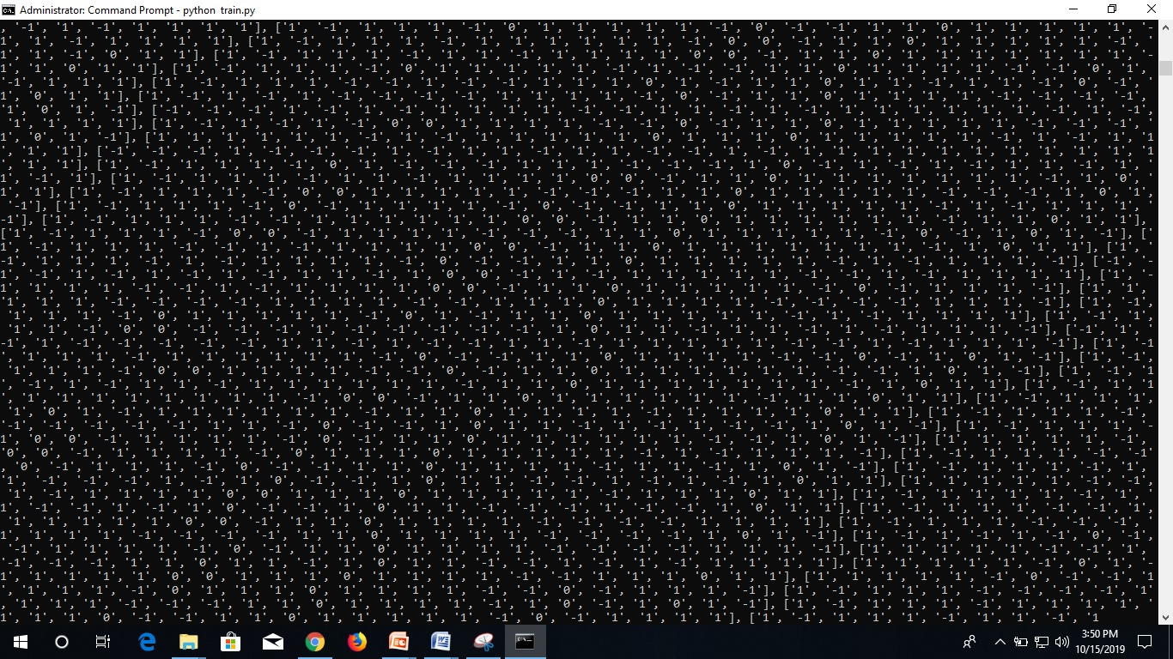
Training the model

Slide 58
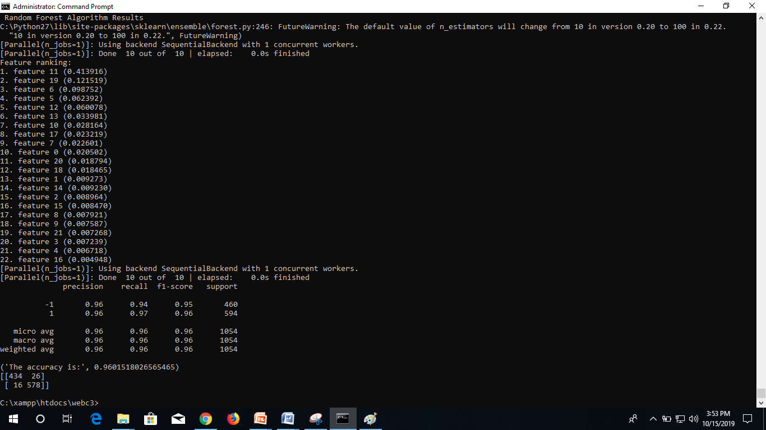
END RESULT

Slide 59
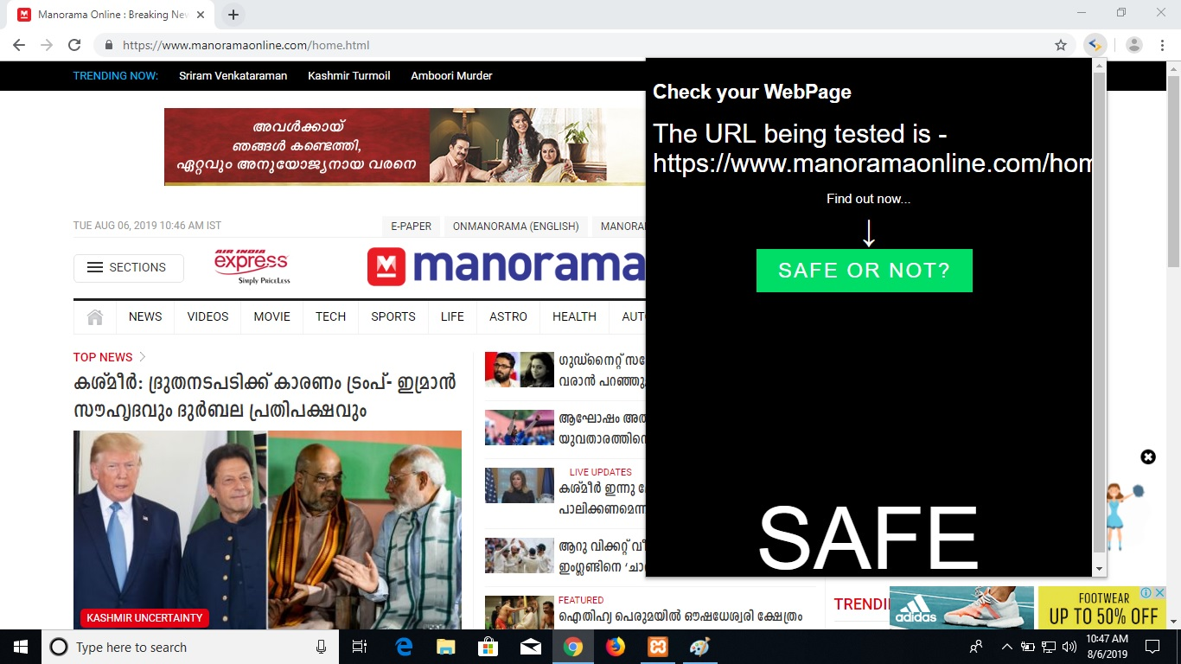

Slide 60
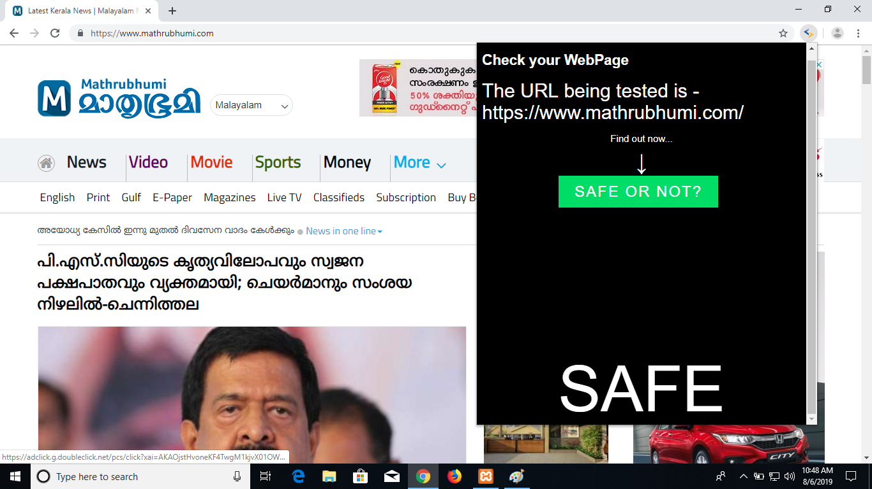

Slide 61


Slide 62


Slide 63
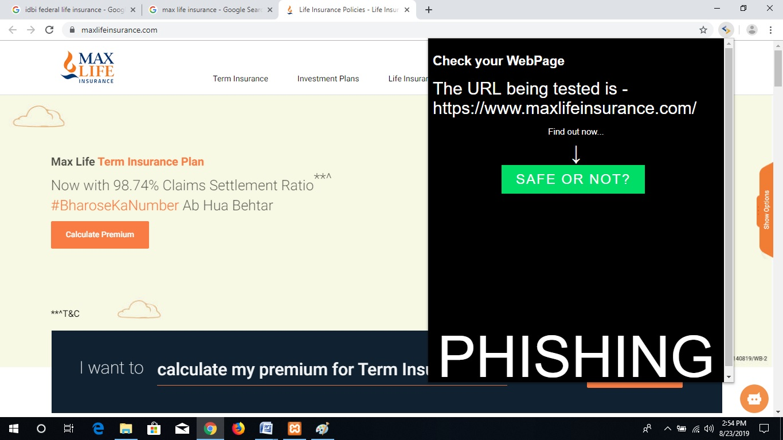

Slide 64
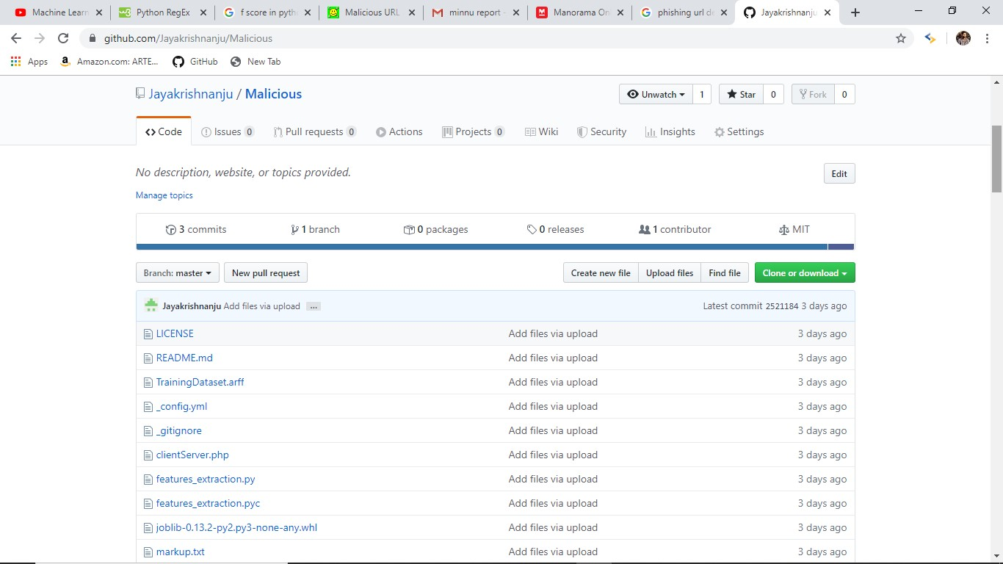
GITHUB PAGE

Slide 65
CONCLUSION
Most of the websites that we commonly visit are malicious/are stealing personal data.
We were able to avoid a good percentage of attacks using our add-on project.

Slide 66


